Slide 1
Cartier
CS 157A - Intro to Database Management
Kunal Pradhan, Apple Ko,
Paing Hein Kyaw, Aye Thwe Tun

Slide 2
What to solve?
A problem often recurring within shoppers is that there is no open source software that allows users to keep track of their shopping lists.
Oftentimes, shoppers have to either pay for subscriptions for shopping list software or they have to manually write them down the lists on a piece of paper with pen or pencil.
Most of the shopping list apps that are free are riddled with ads.
With this app, users will be able to keep track of their shopping list with ease and convenience.

Slide 3
Why Cartier?
This app is an ad-free app that allows users to create shopping lists to keep track of what items they need at the store by creating and keeping track of multiple lists.
Users will be able to create an account and login to their account with the registered username and password.
After creating an account, users will be able to create new shopping lists and separate shopping lists.
Users will then be able to add any desired items inside this list along with some notes/descriptions for the item.
User can also view brands and products in the shops
Users can also add shops to favorites
Users also have the option to add reviews for each shops.
Notes:
This app is an ad-free free to use app that allows for users to create shopping lists online to keep track of what items they need at the store by creating, reading, editing and deleting multiple lists.
Users will be able to create an account and login to their account with the registered username and password.
After creating an account, users will be able to create new shopping lists and separate shopping lists. Users will then be able to add any desired items inside this list.
After finishing shopping each items, users will be able to mark items as purchased until they’re done shopping.
Once users are done shopping, they have the option to add reviews for each shops.

Slide 4
Design Decision
(Architecture)
For this project, we used a 3-Tier Architecture which consists of presentation layer, application layer and database layer.
Scalability
Maintainability of each layer without affecting the entire system.
Security measures within the application to prevent unauthorized access to the database
Locally hosted the application for easy implementation.
Notes:
The 3-Tier architecture makes the app easier to scale and maintain each component since the functionalities are separated into distinct layers.
The modular architecture makes it easier to maintain, update and enhance individual components without affecting the entire system.
We can implement better security measures within the app due to the multiple security measures that we can place at each module to protect the data and prevent unauthorized access.

Slide 5
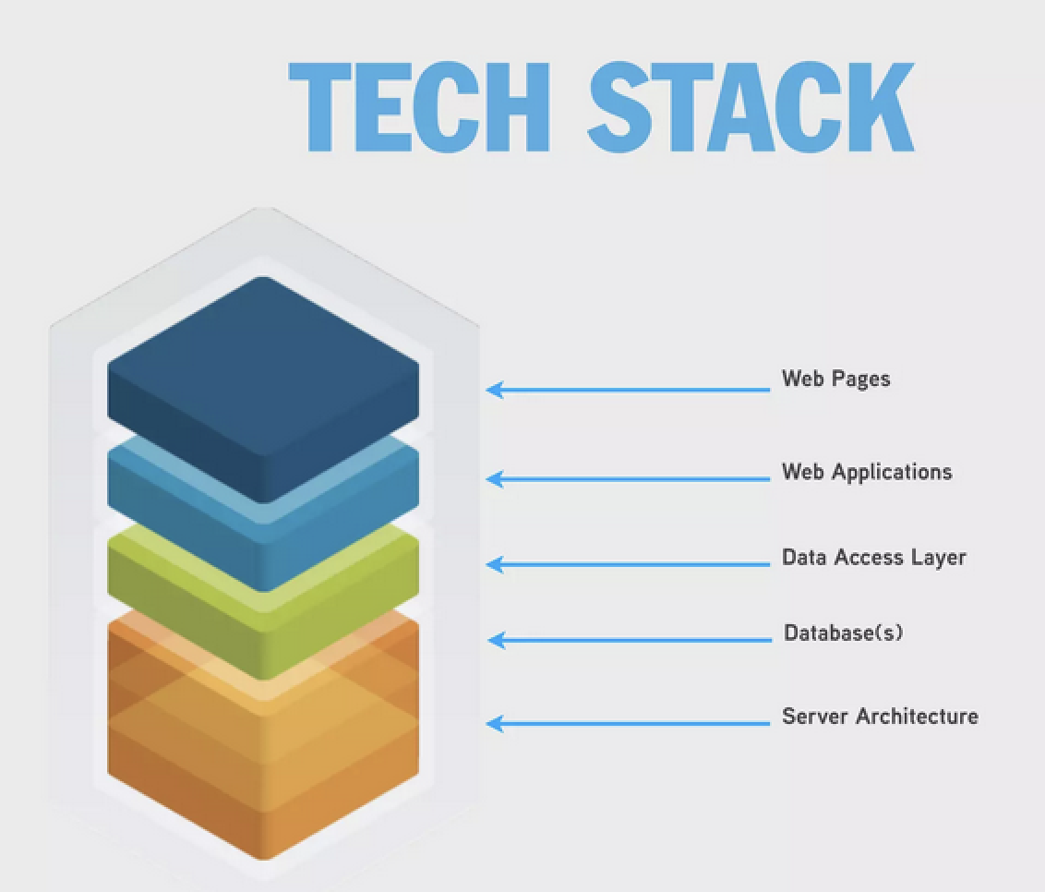
Tech Stack & Tools
Frontend: React.js, Next.js, Tailwind CSS, TypeScript
Backend: Node.js, Express.js
Database: MySQL, XAMPP, Apache, PhPmyAdmin
Version Control: GitHub
Communication: Discord

Slide 6
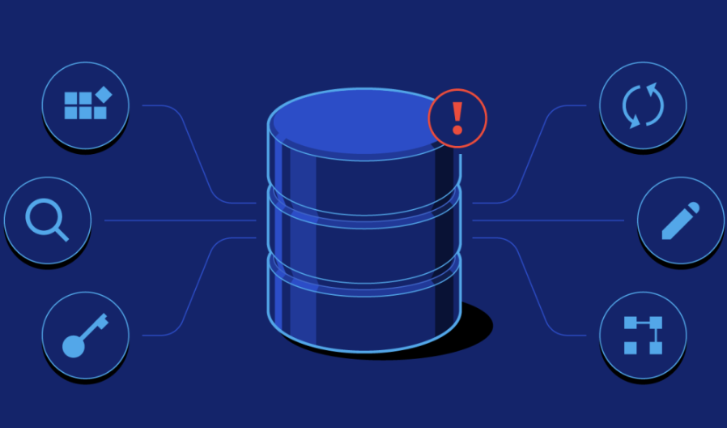
Design Decision
(Database Layer)
XAMPP: open source web server solution stack package, easy to set up local web development environment, all operating systems
MySQL: provides storage system to manage data, allows multiple users to connect to it, ensures data integrity and consistency
PhPmyAdmin: used as middleware between Apache and MySQL, provides a user friendly interface to manage MySQL database through web browser without using command line
Apache: handles HTTP requests from web server and serves static content to client, sends dynamic content requests to PHP

Slide 7
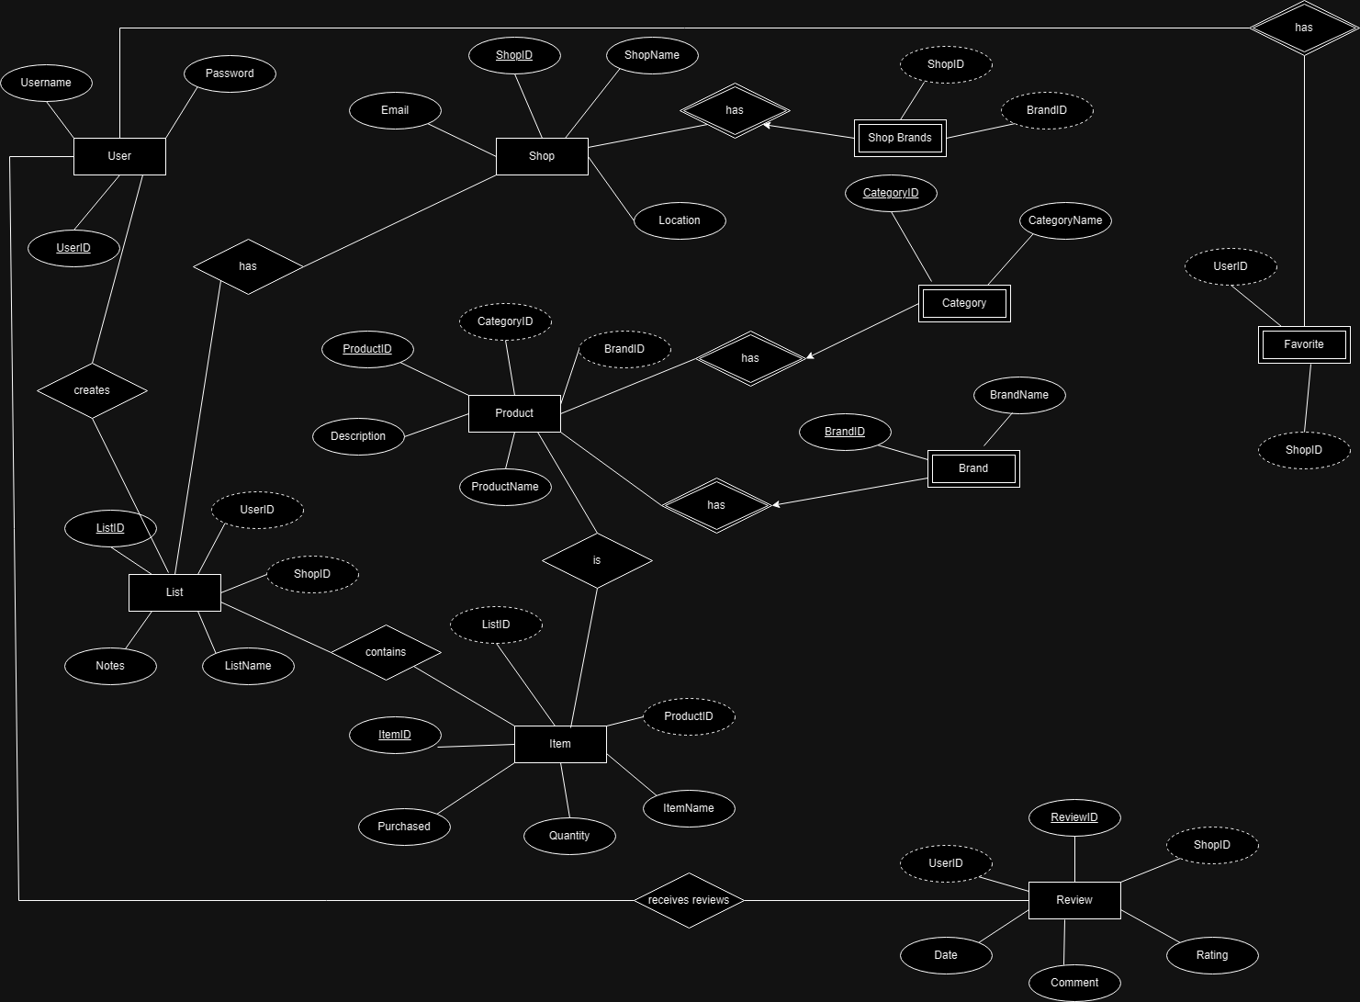
ER Diagram

Slide 8
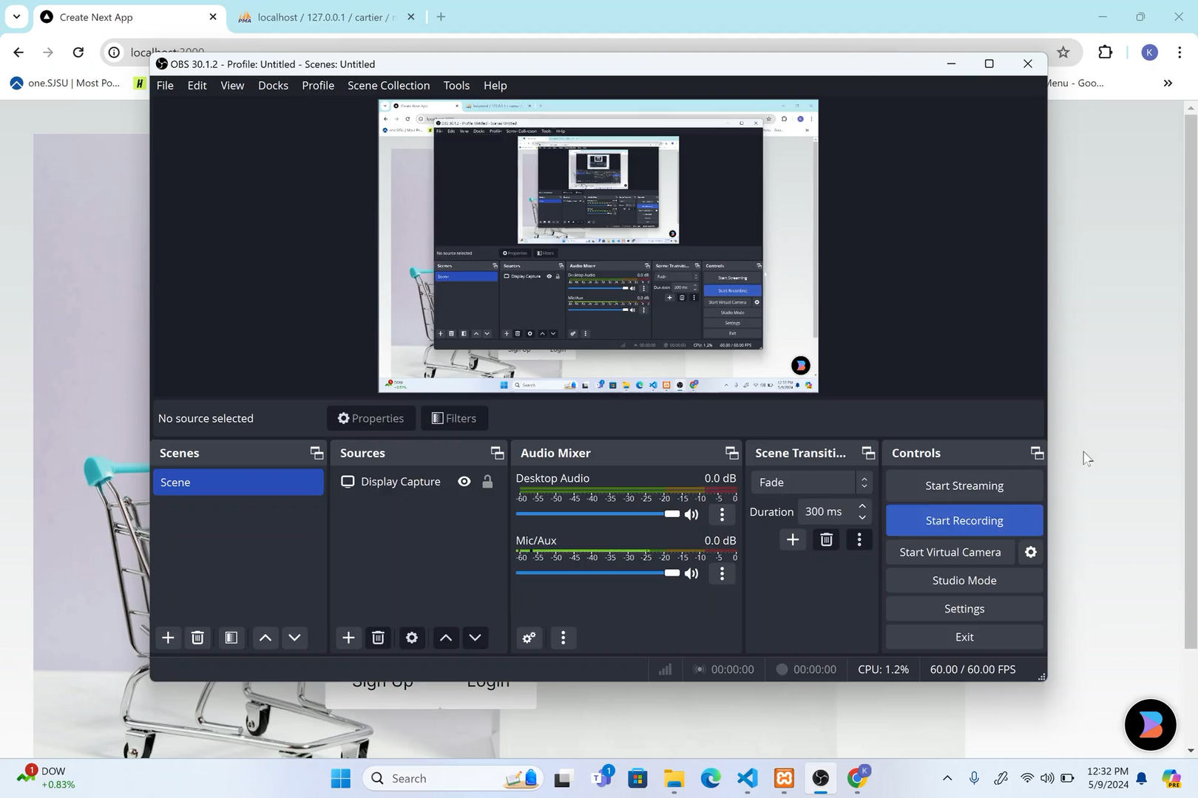

Slide 9
Challenges
User Authentication: Implementing the user login function took a really long time as it was hard to store the userID in the session.
Initial Setup and Config: The other challenge we faced was installing dependencies and packages in our project and making sure that the project was set up correctly for all members of the team.
Limited Skillset: Most members did not have experience in backend development and had to learn how to code in a new programming language during a limited time frame using YouTube tutorials.
GitHub merge conflicts: The main challenge we faced was solving conflicts on Github. Halfway through the project, we started getting errors on our main branch and we couldn’t pull or merge from it.
The problem was solved by reverting commits and adding node_modules into .gitignore file and pushing it again to main.

Slide 10
Future improvements
Implement Update/Delete functions for the Items and Lists
Search Bar that allows users to query lists or shops
More user-friendly and interactive UI

Slide 11
Thank You

